Slide 1


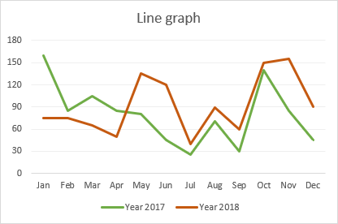

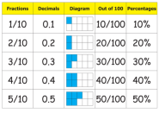
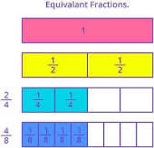
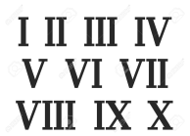
YEAR 5 MATHS LEARNING JOURNEY
Solve comparison, sum and difference problems using line graphs
Complete timetables and use them to solve problems
Year 6
Solve problems involving units of measure using decimal notation and scaling
Statistics
Measures
Convert between standard units of time
Identify, describe and represent the position of a shape following a reflection or translation
Read and interpret information in tables
Estimate volume of cuboids
Geometry
Calculate perimeter and area of rectilinear shapes. Estimate the area of irregular shapes.
Reason about regular and irregular polygons
Convert between units of metric measure
Identify angles at a point, on a straight line and in a whole turn
Percentage and fraction equivalents
Recognise the % symbol and understand meaning of percentage
Draw and measure angles
Percentages
Multiply and divide whole numbers and decimals by 10, 100 and 1000
Decimals
Identify 3D shapes from 2D representations
Scaling and simple rates
Read, write, order and compare decimals up to 3 decimal places
Multiples and factors, square, cube and prime numbers, prime factors and composite numbers
Compare and order fractions
Add and subtract fractions
Fractions
Round decimals with two places to whole numbers and one decimal place
Four operations
Divide numbers up to 4 digits by a one digit number using short and long division
Read and write decimals as fractions
Equivalent
fractions
Multiply proper fractions by whole numbers
Negative numbers
Solve number problems
Multiply numbers up to 4 digits by a one or two digit number using formal written methods
Place Value
Year 5
Number
FDP
Add and subtract whole numbers with more than 4 digits using formal written methods
Roman Numerals
Geometry
Rounding
Order and compare numbers
Measures
H | T | O
Statistics
Ca
count in multiples of 6, 7, 9, 25 and 1,000
find 1,000 more or less than a given number
count backwards through 0 to include negative numbers
recognise the place value of each digit in a four-digit number (1,000s, 100s, 10s, and 1s)
order and compare numbers beyond 1,000
identify, represent and estimate numbers using different representations
round any number to the nearest 10, 100 or 1,000
solve number and practical problems that involve all of the above and with increasingly large positive numbers
read Roman numerals to 100 (I to C) and know that over time, the numeral system changed to include the concept of 0 and place value
add and subtract numbers with up to 4 digits using the formal written methods of columnar addition and subtraction where appropriate
estimate and use inverse operations to check answers to a calculation
solve addition and subtraction two-step problems in contexts, deciding which operations and methods to use and why
recall multiplication and division facts for multiplication tables up to 12 × 12
use place value, known and derived facts to multiply and divide mentally, including: multiplying by 0 and 1; dividing by 1; multiplying together 3 numbers
recognise and use factor pairs and commutativity in mental calculations
multiply two-digit and three-digit numbers by a one-digit number using formal written layout
solve problems involving multiplying and adding, including using the distributive law to multiply two-digit numbers by 1 digit, integer scaling problems and harder correspondence problems such as n objects are connected to m objects
recognise and show, using diagrams, families of common equivalent fractions
count up and down in hundredths; recognise that hundredths arise when dividing an object by 100 and dividing tenths by 10
solve problems involving increasingly harder fractions to calculate quantities, and fractions to divide quantities, including non-unit fractions where the answer is a whole number
add and subtract fractions with the same denominator
recognise and write decimal equivalents of any number of tenths or hundreds
recognise and write decimal equivalents to 1/4 , 1/2 , 3/4
find the effect of dividing a one- or two-digit number by 10 and 100, identifying the value of the digits in the answer as ones, tenths and hundredths
round decimals with 1 decimal place to the nearest whole number
compare numbers with the same number of decimal places up to 2 decimal places
solve simple measure and money problems involving fractions and decimals to 2 decimal places

