Slide 1
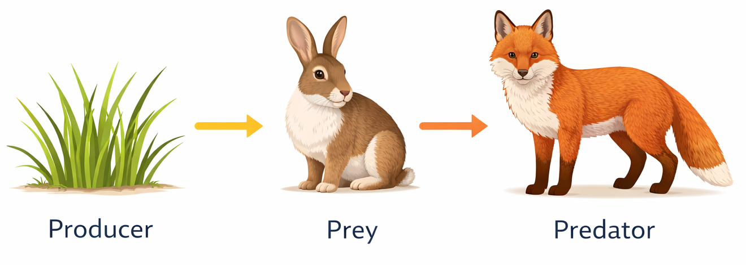
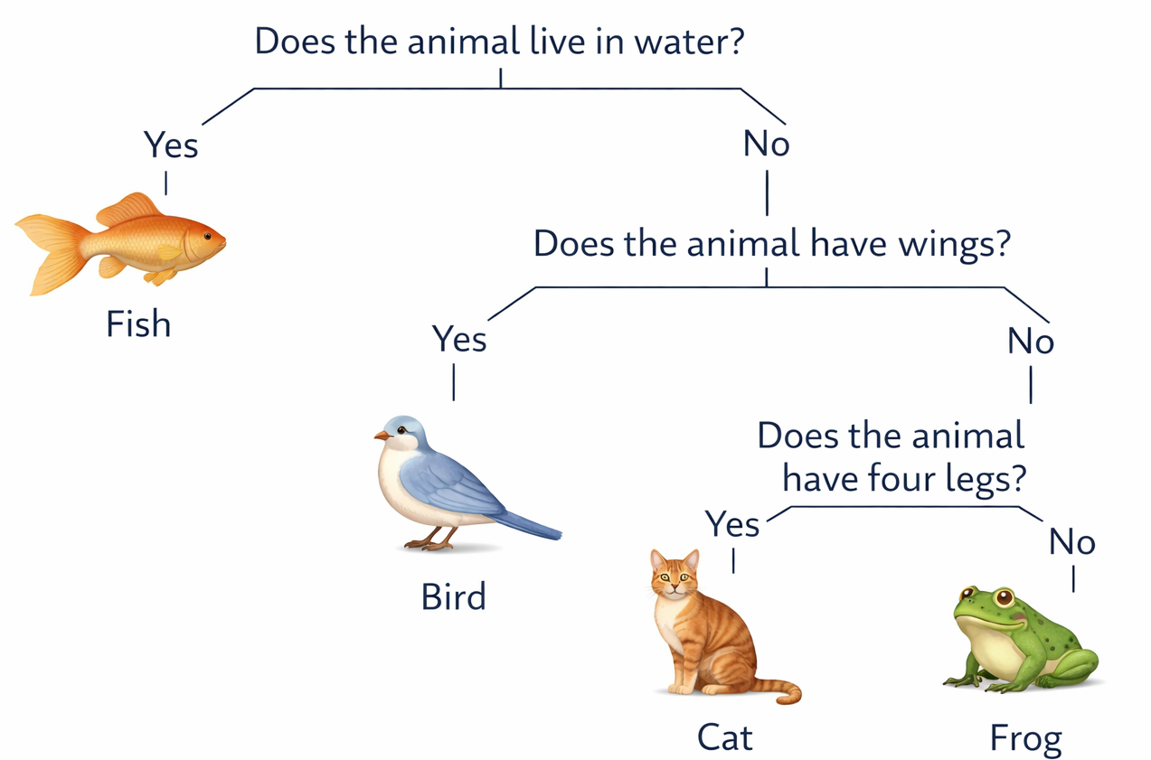
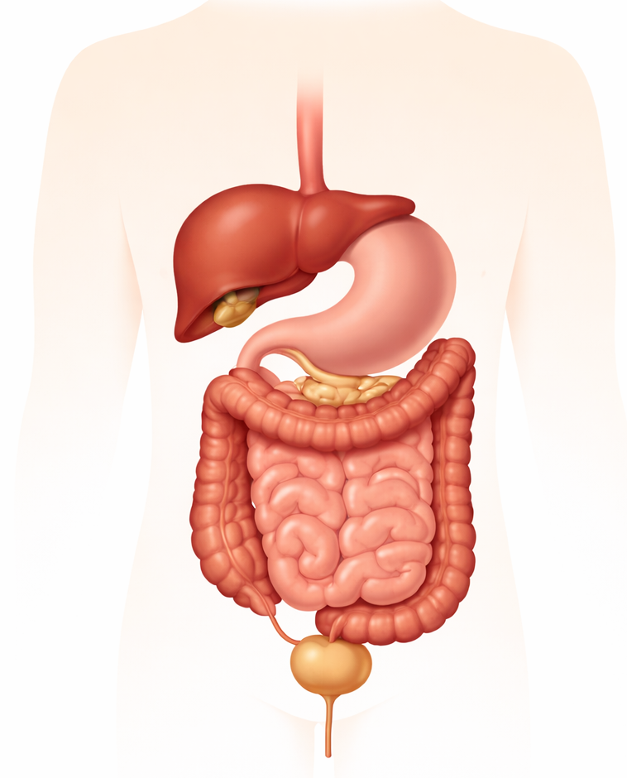
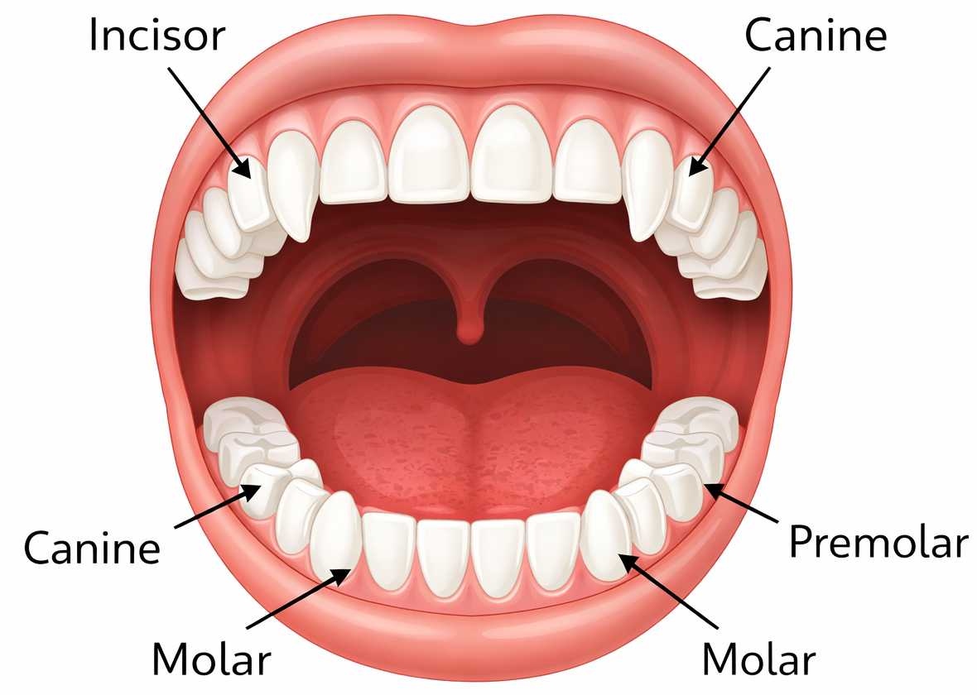
Glossary/Key Vocabulary:
Adaptation – A feature that helps a living thing survive.
Canines – Pointed teeth used for tearing food.
Carnivore – An animal that eats other animals.
Classification – Sorting living things into groups.
Classification key – A set of questions used to identify something.
Consumer – An animal that eats plants or other animals.
Digestion – The process of breaking food into small parts the body can use.
Digestive system – The parts of the body that break down food.
Food chain – A way of showing how energy moves between living things.
Habitat – The place where a plant or animal lives.
Herbivore – An animal that eats plants.
Incisors – Front teeth used for cutting food.
Invertebrate – An animal without a backbone.
Large intestine – Where water is taken from waste.
Molars – Flat teeth used for grinding food.
Omnivore – An animal that eats both plants and animals.
Oesophagus – A tube that carries food from the mouth to the stomach.
Predator – An animal that hunts and eats other animals.
Prey – An animal that is hunted and eaten.
Producer – A plant that makes its own food using sunlight.
Saliva – Liquid in the mouth that helps soften food.
Small intestine – Where nutrients from food are taken into the body.
Stomach – A bag that mixes and breaks down food.
Teeth – Hard parts in the mouth used to bite and chew food.
Vertebrate – An animal with a backbone.
How do animals survive?
How do animals survive?
What is a human?
How did where the Anglo-Saxons settled help them survive?
Why do we need to protect these species?
How can change impact an environment?
How are nature’s species so brilliantly adapted to their environment?
Key Facts
Food is broken down in the body during digestion.
The digestive system helps the body get nutrients from food.
Food travels from the mouth to the stomach and then to the intestines.
Different teeth have different jobs: incisors cut, canines tear, and molars grind.
Animals (including humans) need food to get energy to survive.
A food chain shows how energy moves between living things.
Plants are producers because they make their own food.
Animals are consumers because they eat plants or other animals.
Predators hunt other animals.
Prey are animals that are hunted.
Energy starts with the sun and moves through the food chain.
Living things can be grouped based on their characteristics.
A classification key helps us identify living things.
Animals need food, water, shelter and space to survive.
Environments can change over time.
Changes in the environment can be dangerous for living things.
Anglo-Saxons chose places to settle near water, farmland and shelter.
Settling in the right place helped them find food and stay safe.
Humans, like animals, need the right environment to survive.
stomach
Large intestines
Small intestine
Bladder
rectum

