Slide 1
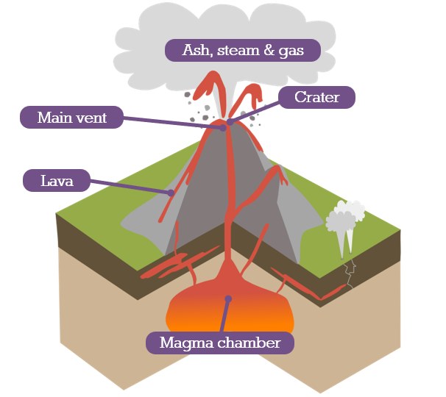
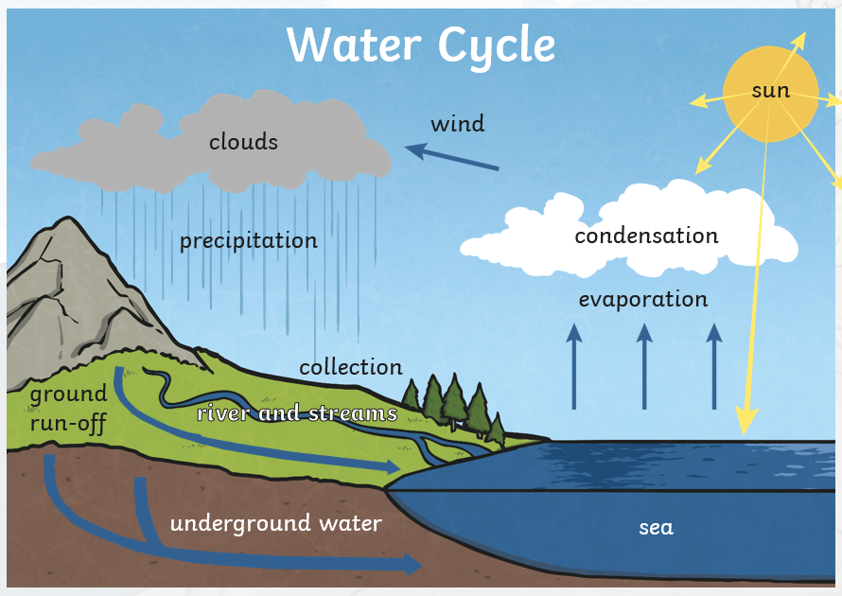
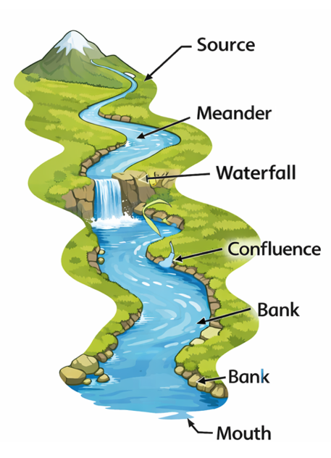
Glossary/Key Vocabulary:
Physical feature – A natural part of the Earth, such as a mountain, river or volcano.
Summit/Peak– The very top of a mountain.
Valley – Low land found between mountains, often with a river.
Base – the bottom of a mountain
Magma – Hot, melted rock, under the Earth’s surface.
Lava – Melted rock that has erupted.
Crater – The opening at the top of a volcano.
Natural disaster – A dangerous natural event that can cause damage, such as an earthquake or eruption.
Earth’s Crust - The hard outer layer of the Earth where we live
Estuary - a wide part of a river where the fresh water from the river meets the salty water from the sea.
Evaporation – When water warms up and turns into a gas.
Condensation – When water vapour cools and turns back into tiny droplets.
Source – The place where a river begins.
Mouth – The place where a river flows into the sea, lake or another river.
Confluence – where a river splits.
Meander – the bend in a river
Rock – A hard natural material that makes up the Earth’s crust.
State of matter – The form something is in: solid, liquid or gas
How is the natural world unpredictable?
How is the natural world unpredictable?
What physical features are in the natural world?
What is a natural disaster and how do they happen?
How does it rain?
How do rivers shape the land and lives of people?
Why do people settle in natural hazard areas?
Key Facts
Physical features
Mountains and volcanoes are natural features.
Parts of a mountain: base, slope, peak, summit, valley.
Mountains around the world: Mount Everest, Mont Blanc, Carro Aconcagua, Mount Elbert.
Mountains in the UK: Ben Nevis, Scafell Pike, Snowdon.
Parts of a volcano: magma chamber, crater, main vent, ash cloud, lava flow.
Molten rock is called magma under the Earth and lava when it erupts.
Natural disasters
Volcanic eruptions and earthquakes are natural disasters.
Mount Vesuvius is Europe’s only active volcano; it destroyed Pompeii.
Earthquakes are caused by movements of the Earth’s crust.
Earthquake hotspots: Indonesia, Mexico, California, Philippines, India, Nepal.
Volcano
The Water Cycle

