Slide 1
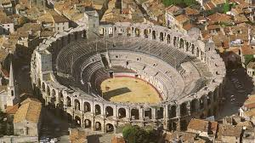
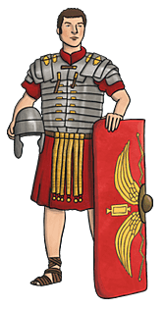
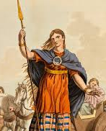
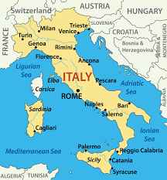
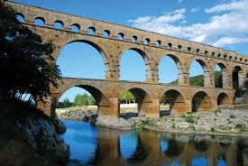
Glossary/Key Vocabulary:
BCE – Before Common Era.
CE – Common Era.
AD – Anno Domini
BC – Before Christ
Chronological - events arranged in time order.
Timeline – a diagram that shows historical events in Chronological Order.
Period – a defined section of time.
Millennium – a period of one thousand years.
Britons – the Celtic peoples who inhabited Great Britian before the Romans.
Celts – a collection of tribes in Britain
Emperor – the male ruler of an empire.
Empire – a collection of countries ruled by one person.
Europe – a continent in the Northern Hemisphere.
Invasion – when people forcefully enter another person’s land or country to control it.
Invade – to enter a place by force.
Iron Age – prehistoric period following the Bronze Age.
Kingdom – a place ruled by a king or a queen.
Latin – a language used in Ancient Rome
Tribe – a group of people who share the same language, beliefs and ways of life.
Rome – capital city of Italy
How did the Roman invasion change life in Britain?
How did the Roman invasion change life in Britain?
Who lived in Britain before the Romans?
What was life like in Roman Britain?
What was life like in the Roman Army?
Should the Romans have invaded?
How did the landscape influence the invasion?
Early Britain:
The Celts lived in Britain and Ireland from 750BCE.
The Celts lived in mud, clay and straw huts.
Roman Invasion of Britain:
Emperor Augustus the first Emperor of Rome wanted to expand the empire.
The Romans had an organised, well-trained army.
Emperor Claudius invaded Britain in 43 BCE and within 4 years Rome controlled large areas of Britain.
Queen Boudicca (Celtic queen) fought against the Romans who took her land.
Her army burned down Roman cities as a revolt against the Romans. – London, Colchester and St Albans.
Roman Britain:
The Romans came from Italy. (A country in Europe)
The Romans invaded Britain to gain valuable metals, slaves and farmland.
Romans built towns, paved roads and public baths.
The Romans introduced written language to Britain, new medical practices and Christianity.
The Fall of the Roman Empire:
During the 3rd century, the Roman Empire was experiencing a lot of civil wars.
The Celts and other tribes were continuing to revolt against the Romans in Britain.
The Roman Army was taken back to Rome to stop the civil wars in 410CE.
Amphitheatre
Aqueduct
Roman Soldier
Boudicca
Italy

